Slide 1
Language Buffet
Problem solving exploration
Notes:
A direct comparison of how different languages solve the same, simple problem.
Encourage exploration.
Help you choose your next language to learn.

Slide 2
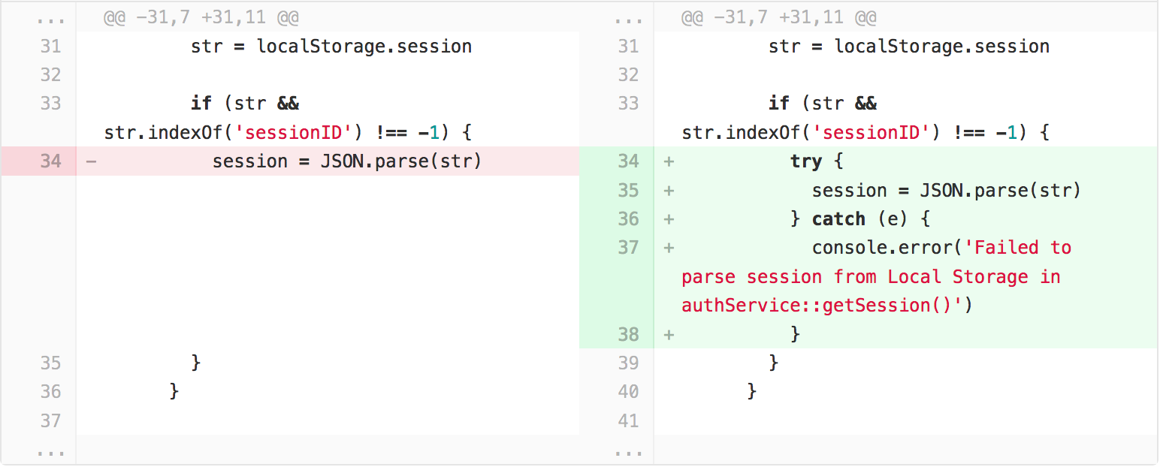
How it started
Notes:
An unsuspecting commit was destined for greatness.
Total head-slapper.
Why does JavaScript allow us to do this?

Slide 3

Do other languages fare better?
Notes:
Nope. They have different goals and trade-offs.
I’m not here to ridicule languages or praise them, only present the process I went through to solve the same problem in each.
We create a simple, concrete problem that’s like a greater hello world exercise.
We have a chess club application that gets players’ JSON data from an API somewhere.
Art Credit:
https://www.udemy.com/chess-strategy/

Slide 4
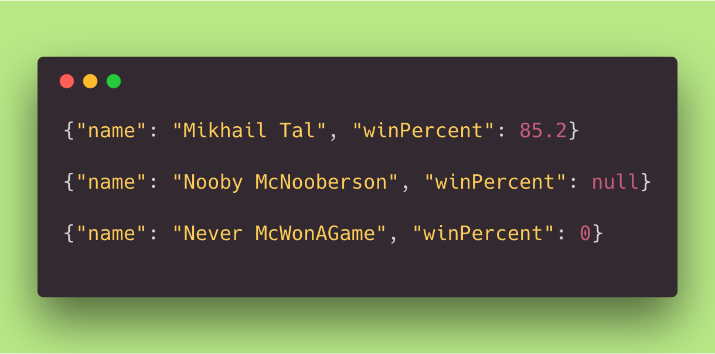
Valid JSON
Notes:
Zero and null have distinct meanings.
In some languages there might be a difference between zero with and without a decimal i.e. 0.0, as one is an integer and the other is a float.
The goal is introduce the player based on this data.
Handle stuff that could go wrong.

Slide 5
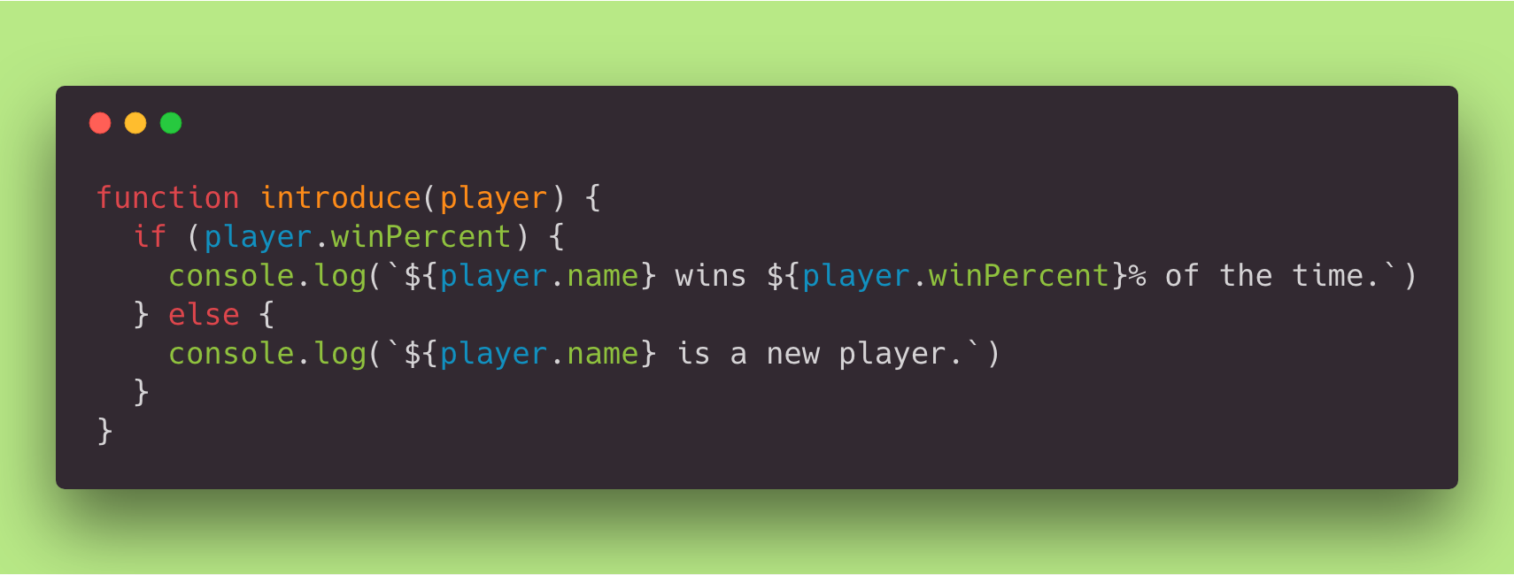
JavaScript
Notes:
Oh crud. We’ve made a mistake already.
What’s wrong with this function?
Would you have remembered to make test specifications for both the null and zero cases of winPercent?

Slide 6
Ensuring Safety
With more codez

Slide 7
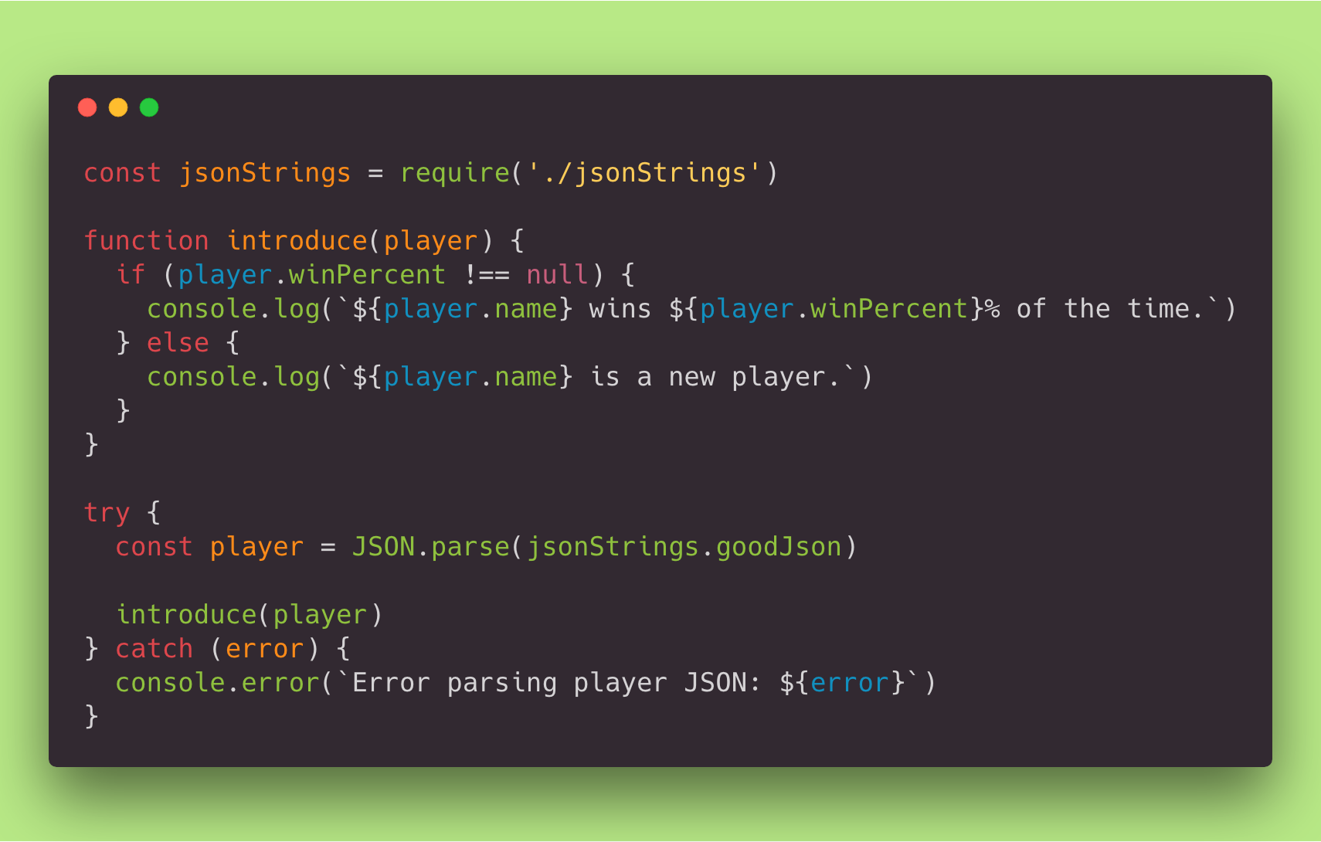
Notes:
We have JSON strings in a local file that we import, instead of mocking HTTP requests and responses.
Introduce function improved.
We handle bad JSON.
What if the player object’s winPercent key is absent?
What if the JSON has totally different properties?
What if the JSON has the right property names, but different data types?

Slide 8
A package for that
Of course there is

Slide 9
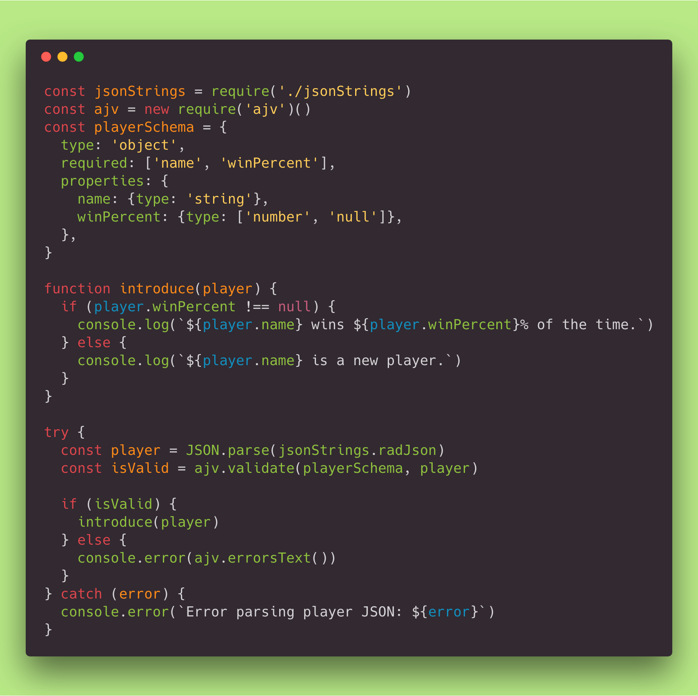
Notes:
Don’t just parse. Validate the JSON!
Third party library.
A lot of languages have a JSON validation implementation of some kind.

Slide 10
TypeScript
Now with more colons!

Slide 11
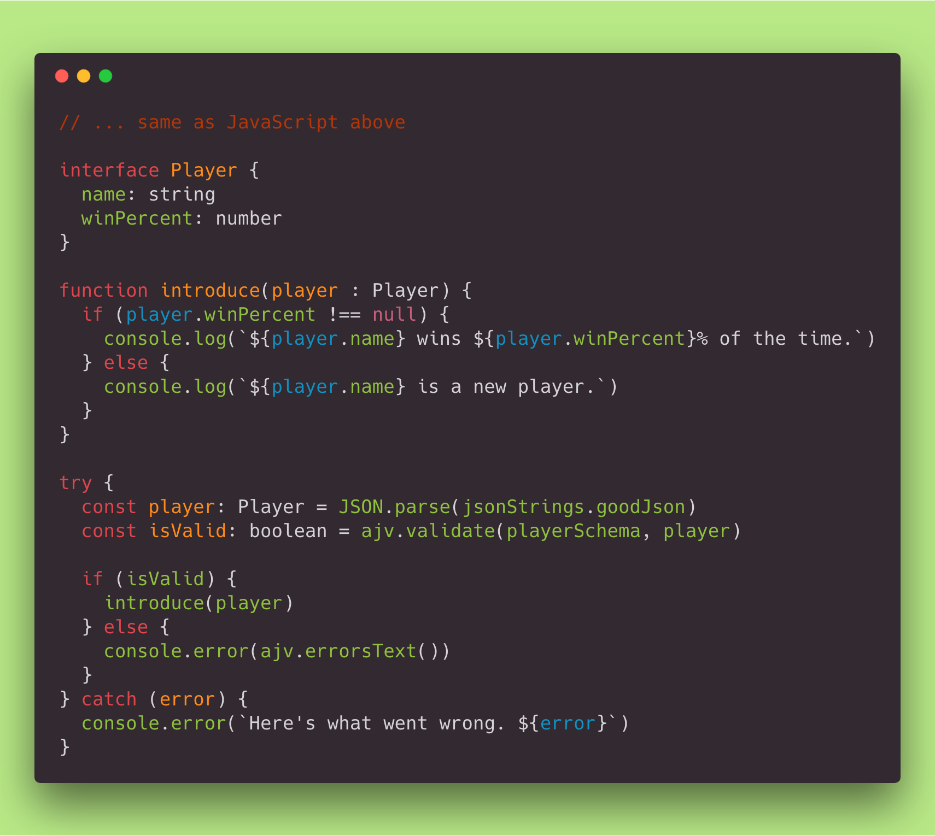
Notes:
In addition to colons, TypeScript adds a compilation step.
Text editors can do smart code completion.
You might want typings for third-party code, which can be another hoop to jump through.
All fields can be null in TS by default, which we expect for our winPercent field.
If we don’t have that !== null check, the compiler will still build.
TypeScript does not enforce that you catch exceptions where they could arise.
It allows you to delete keys from objects and thus violate their contracts.
You need to do the same thing twice, sort of, when dealing with outside data.
Having that Player interface is not enough to enforce that because the value of the player const is determined at run-time.

Slide 12
Similar languages
Literally side by side
Notes:
The approach we saw in JavaScript is not unique.
Other languages will handle this in almost exactly the same way.
If you know how to solve a problem in one language, you probably know how to solve a similar problem in some languages you’ve never seen before.
The following four slides shows two implementations side by side. Can you name the two languages there?
BETTING BEGINS

Slide 13
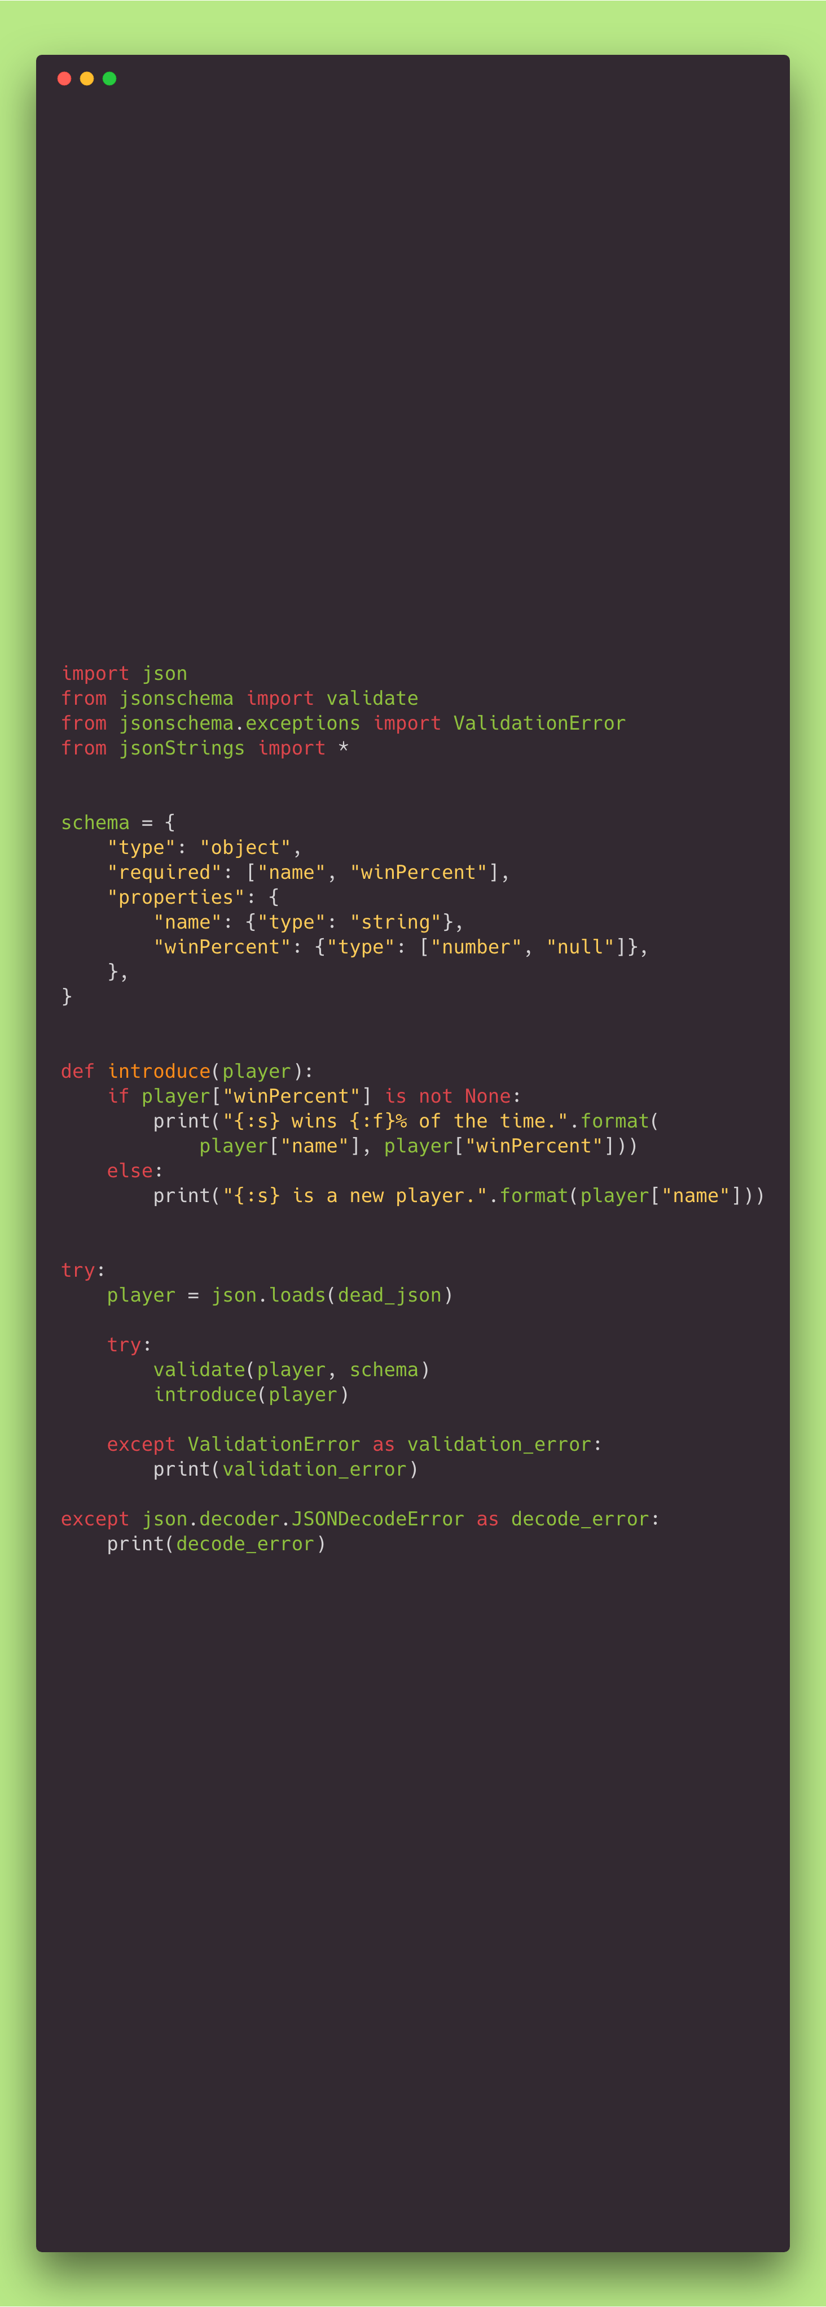
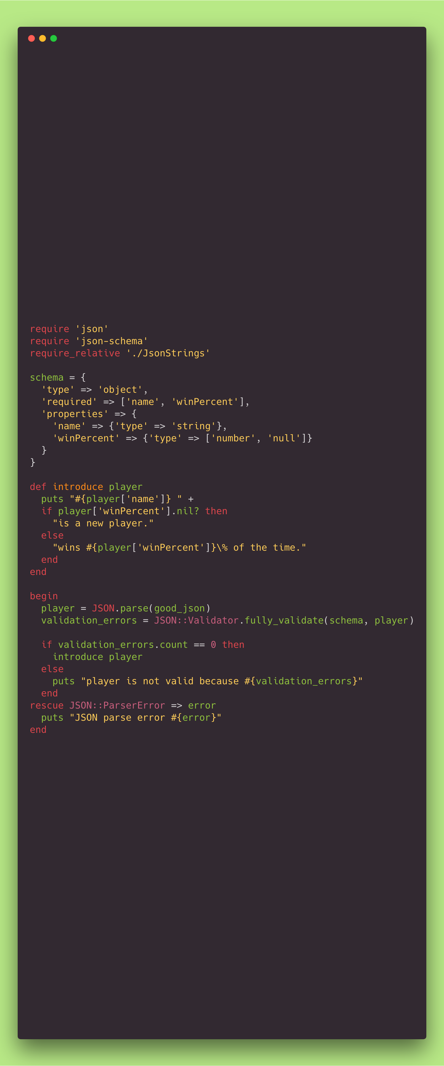
Notes:
Both of these were really easy to implement, though I have experience with Ruby, and nearly zero experience with Python.
Python:
Lack of curly braces and “end” keywords.
Instead it uses colons and whitespace.
Null is “None”.
Catch is “except”.
You import local files the same as package dependencies.
JS-like hashes.
Ruby:
“require_relative” is for your local files.
Everything returns. See how the introduce function uses string concatenation with an if statement.
Functions can have cool question marks and exclamation points in them.
Try/catch in begin/rescue/end.
Class-level members can be access via “::” though it’s not necessary to do it this way.
Hash rockets!

Slide 14
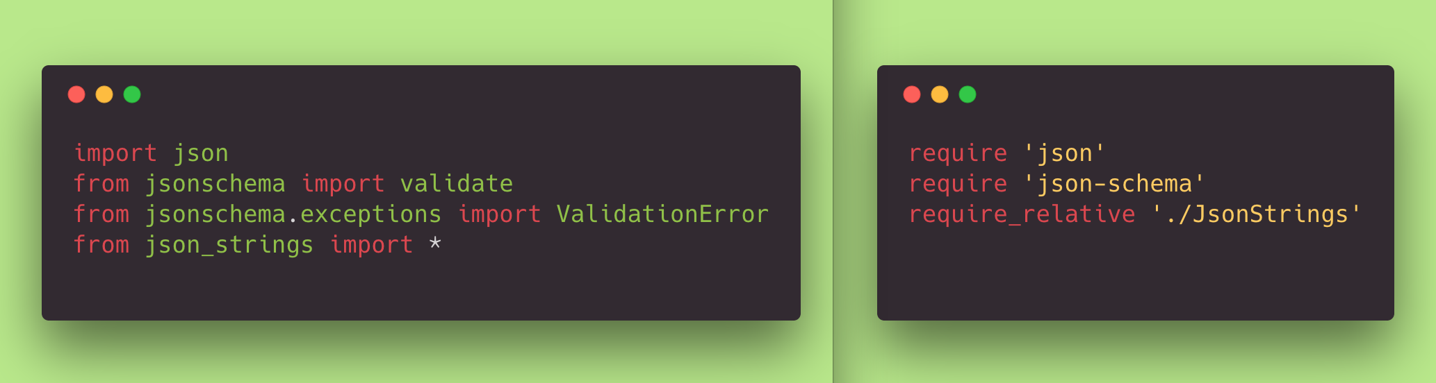
Notes:
What do we think * does?
What does require_relative do?

Slide 15
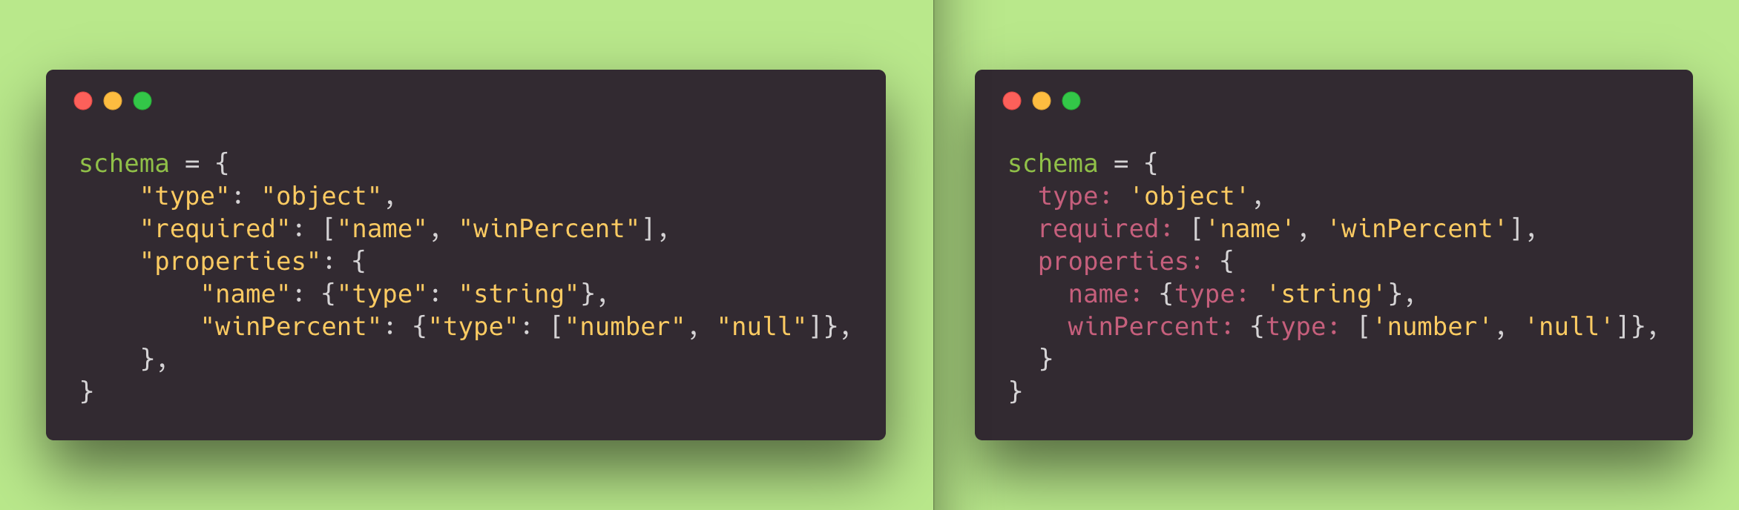
Notes:
The one on the right can use hash rockets as well.
Both allow trailing commas.
Both allow use of double or single quotes.
The one on the left does not symbols like the one on the right.

Slide 16
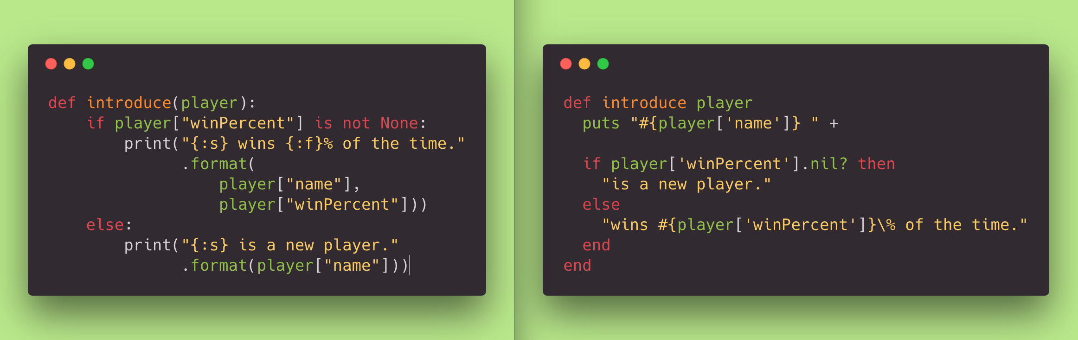

Slide 17
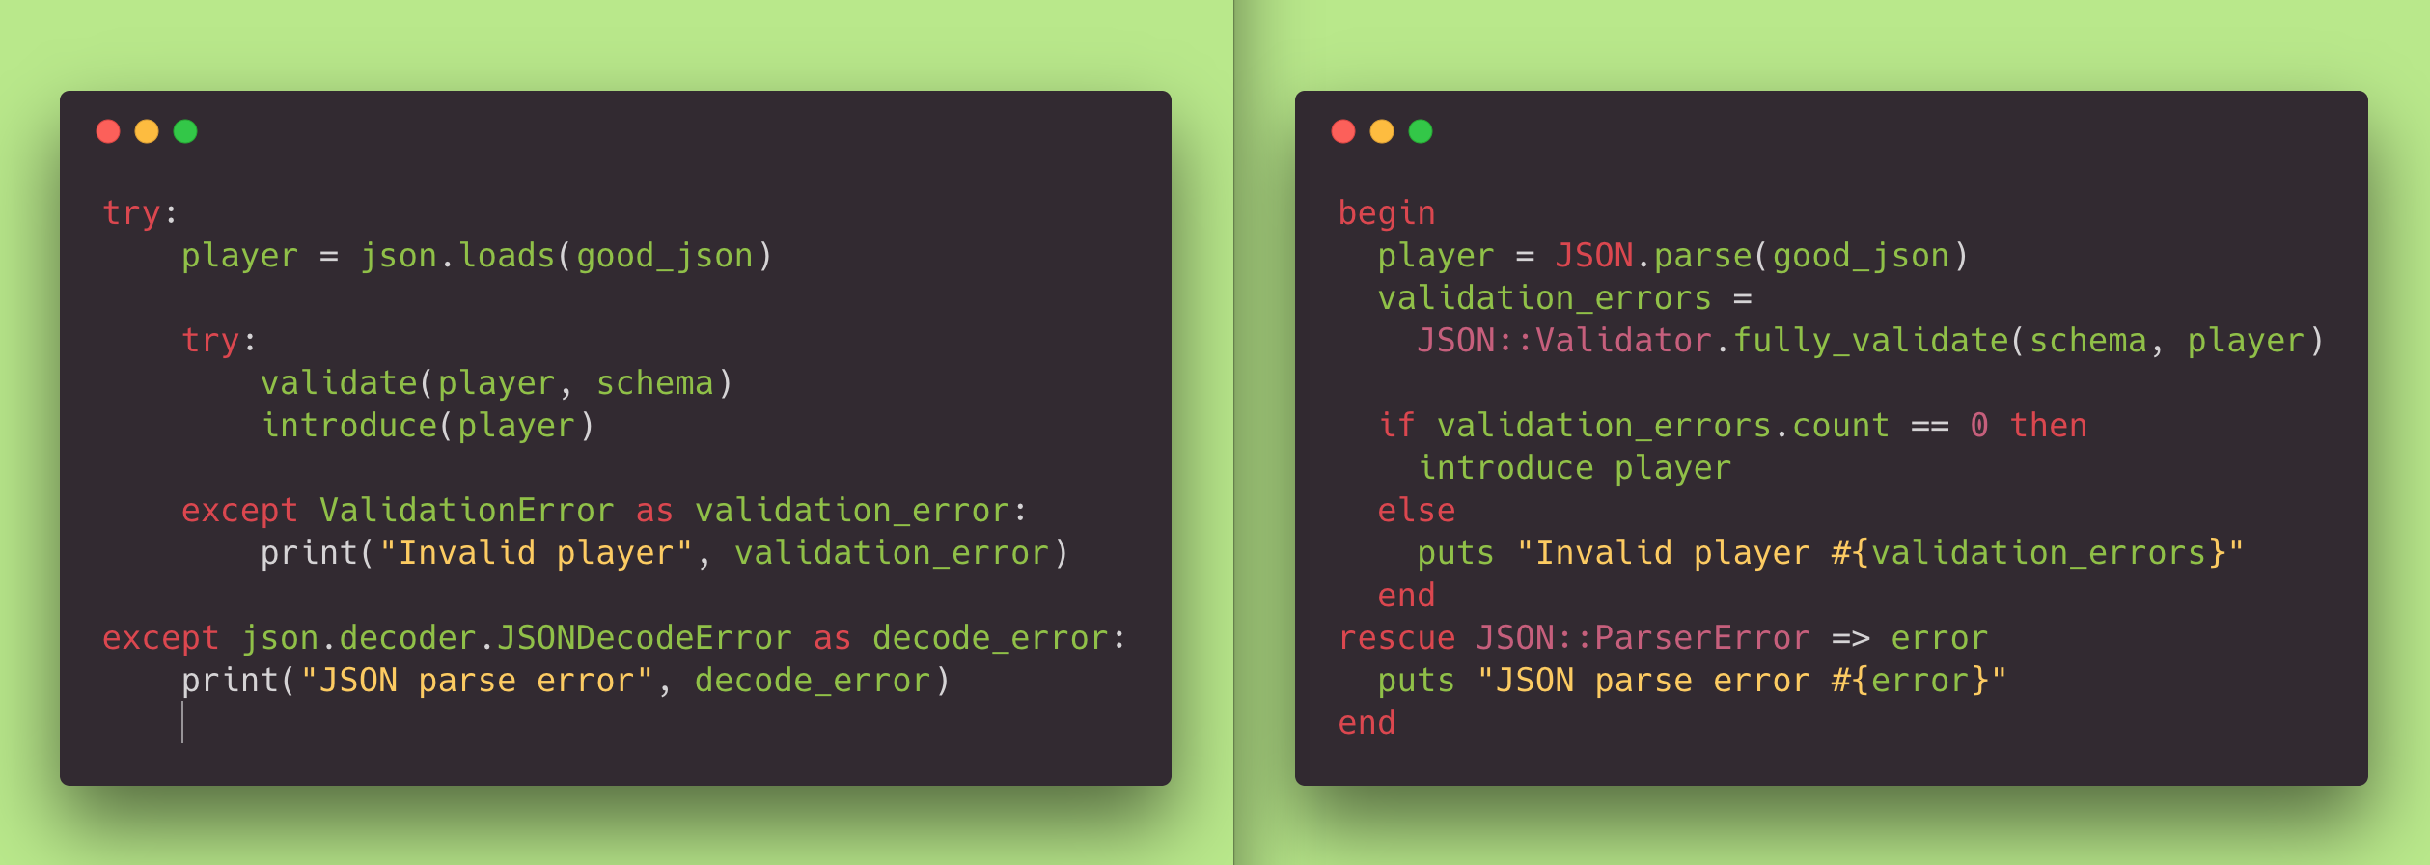
Notes:
Wrap-up.
Why use Python? Tensor-flow.
Why use Ruby? Rails.

Slide 18
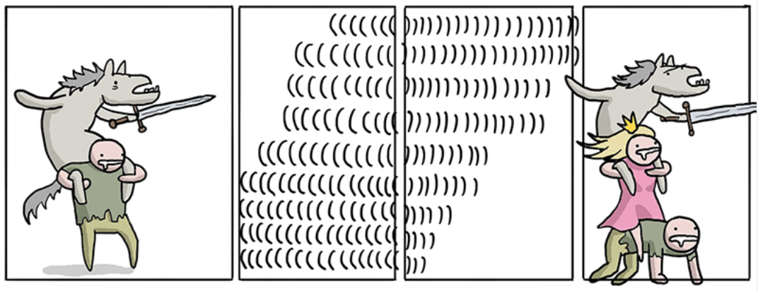
Notes:
Art Credit: https://toggl.com/programming-princess/
Next language is…

Slide 19
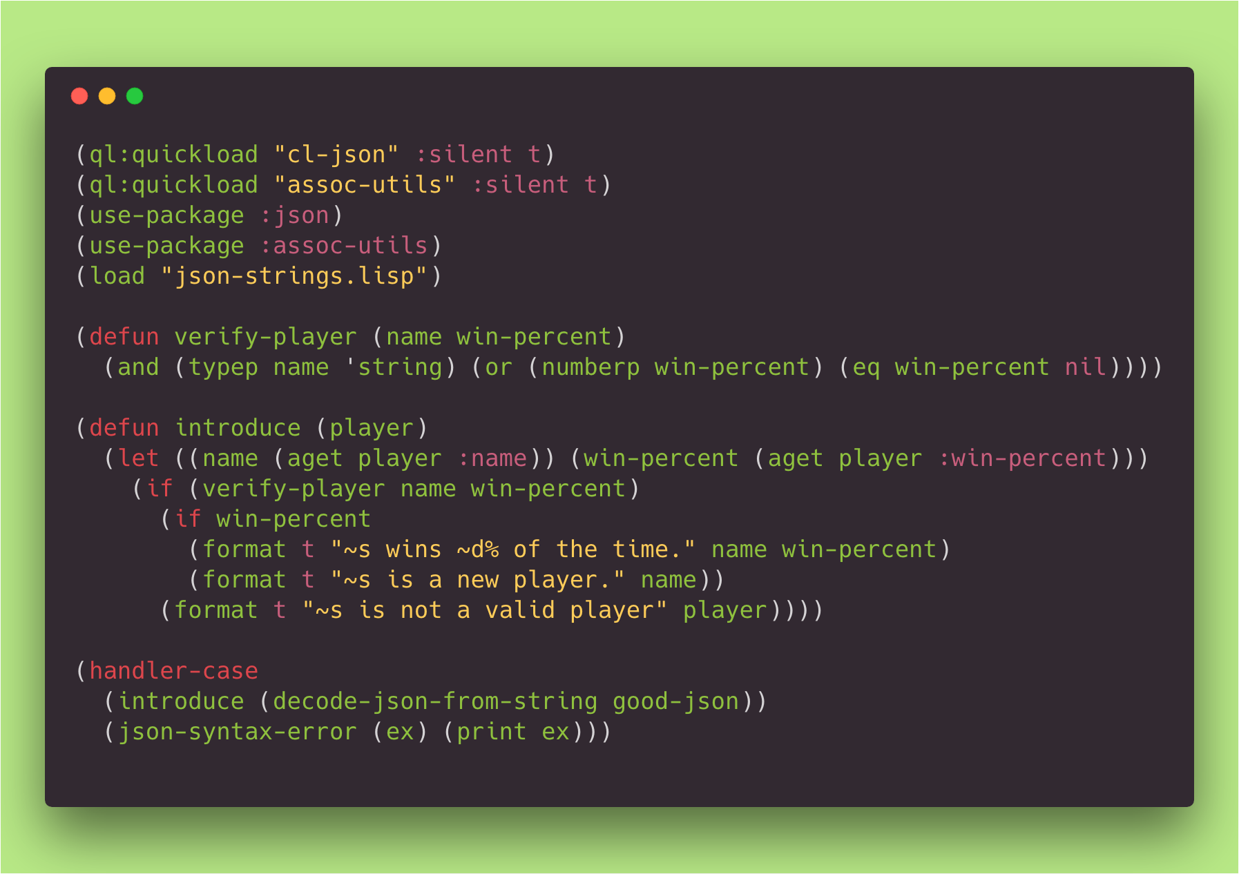
Notes:
Somebody other than Michael or Paul explain to me exactly what’s going on here.
Explain “t”.
Big problem with the package manager, quicklisp, for common lisp.
It took too long to get a package manager up and running.
What packages exist for json-schema in Lisp are not published to quicklisp.
So, I rolled my own instead of copying and pasting somebody else’s code.
Decoding the json creates a list of pairs, or an association list.
These are also called "dotted pairs.”
When you print it out, it looks like ((:NAME . "Nooby McNooberson") (:WIN-PERCENT . 88))
in JS-land that would look like [['name', 'Nooby'], ['winPercent', 85.2]]
We don’t get into metaprogramming here.

Slide 20
Notes:
Art Credit:
https://xkcd.com/224/

Slide 21


Lambda Balls
By that guy
Notes:
Art Credit:
https://clojure.org/
https://leiningen.org/

Slide 22
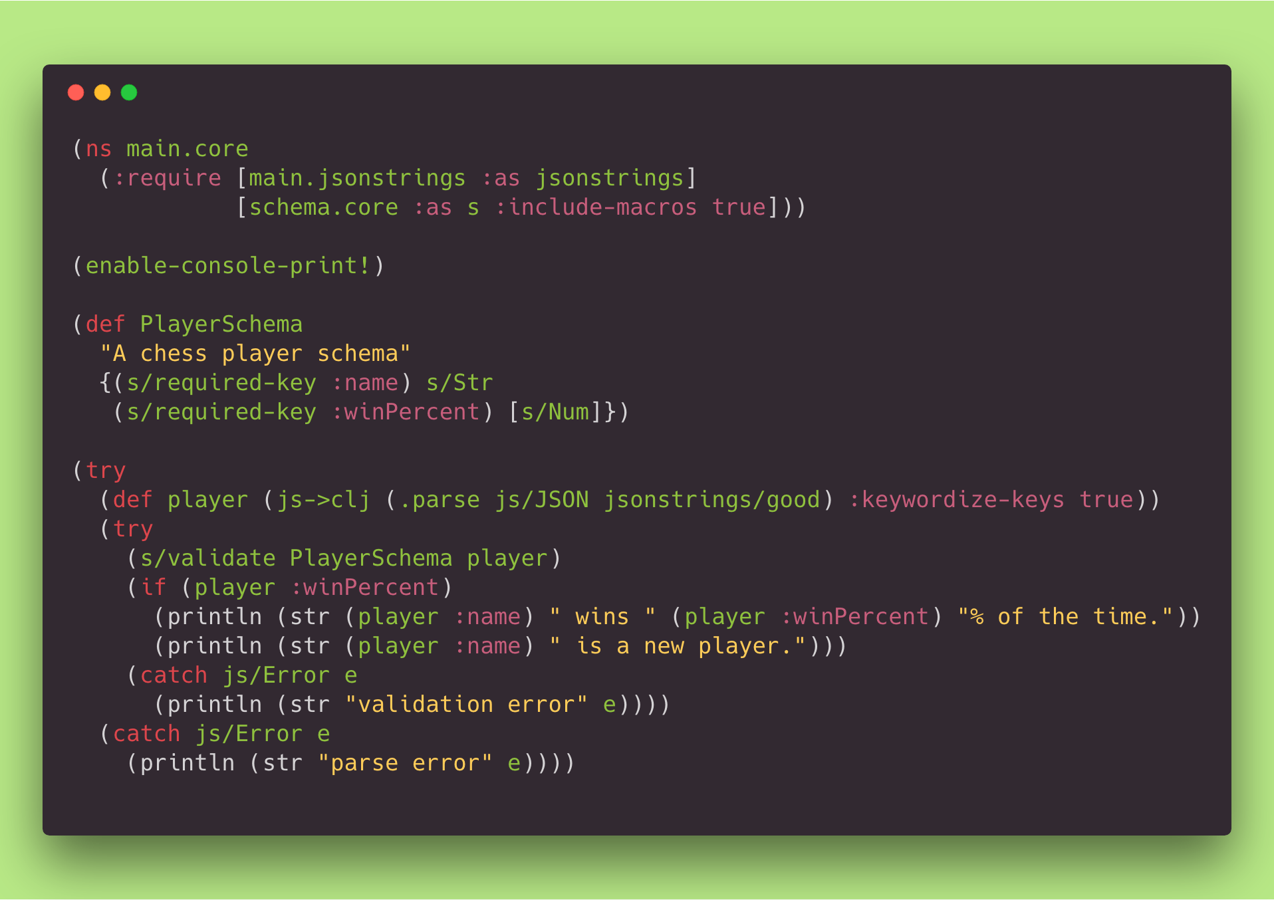
Notes:
The require call will silently fail if you have more than one of them.
Then only the last thingy you require will actually get loaded!
This ate probably five hours of my life.
I was able to use a package manager. https://leiningen.org/
The compiler throws Java Exceptions.
This compiles to a JavaScript file that is 1.4Mb large, minified.

Slide 23
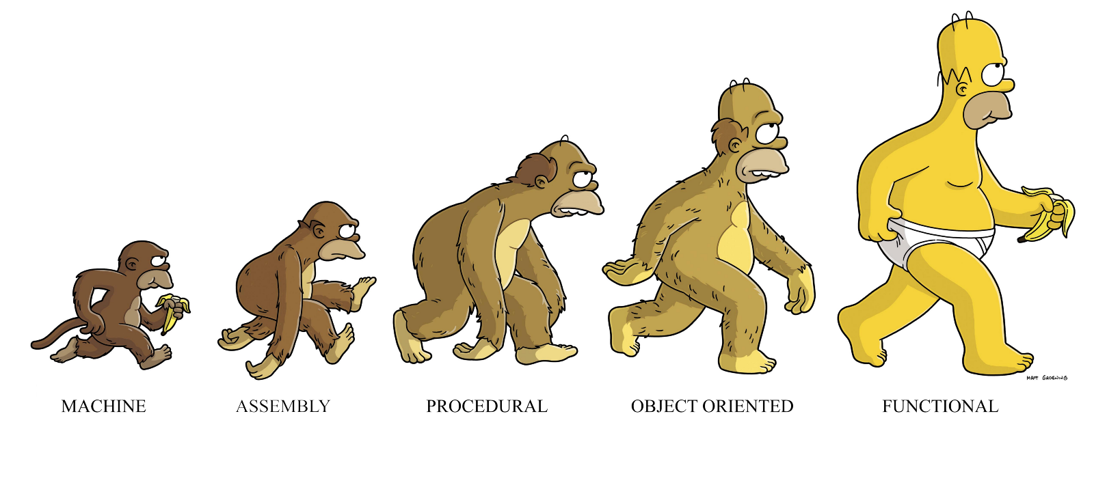
Snobbery
It’s unavoidable.

Slide 24
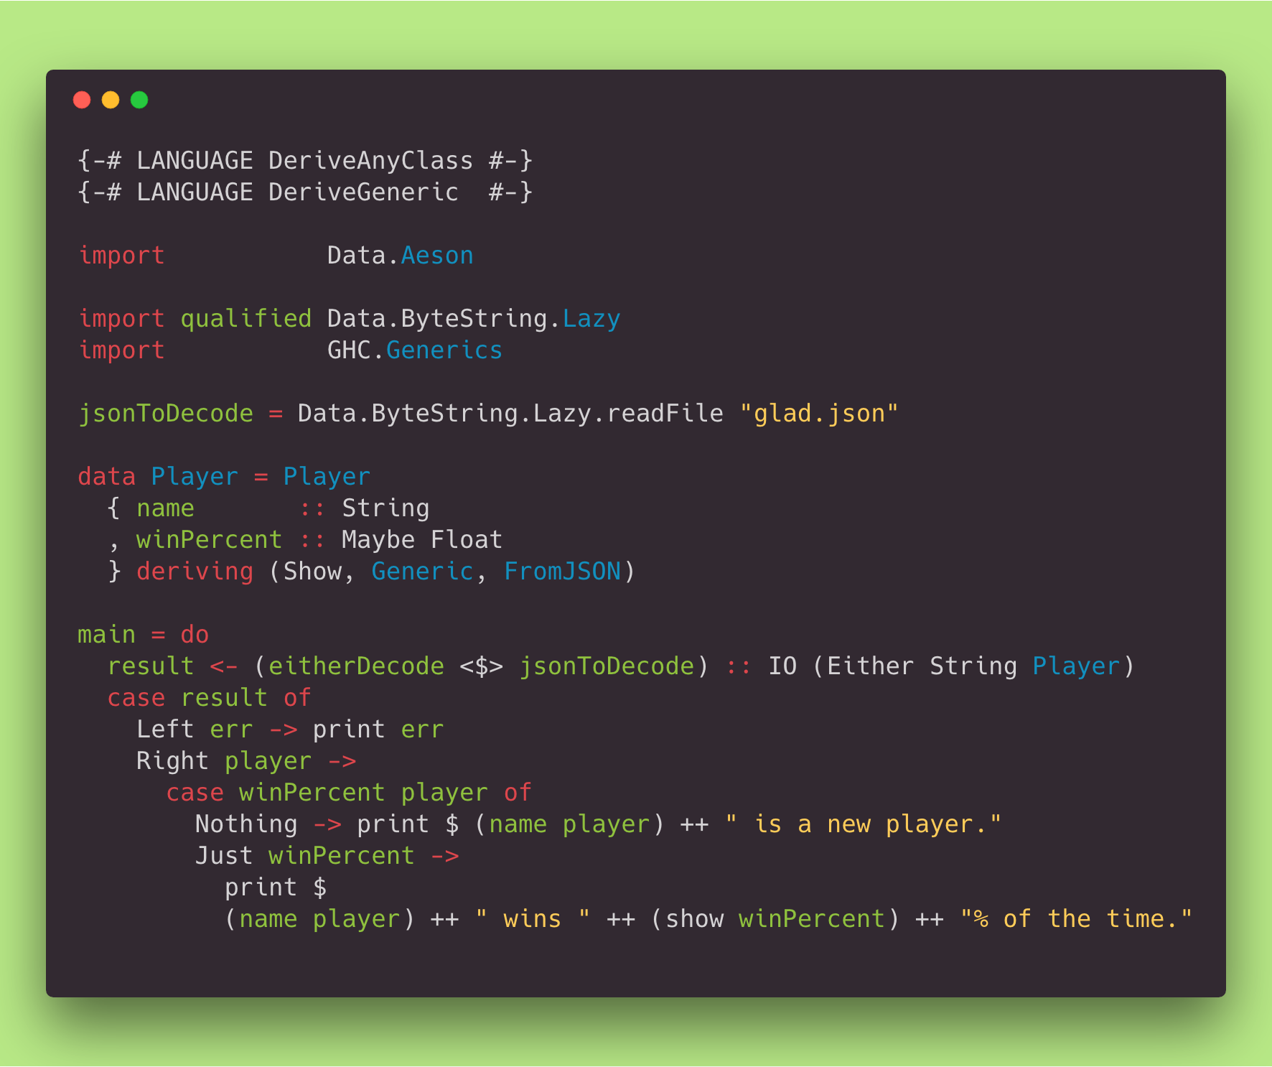
Notes:
This was hard.
It’s Haskell, by the way.
Compiler flags at top.
The “deriving” we see here is a macro to generate code for us.
There are way too many symbols.
We can talk about some of the concepts here later.
Hoogle is cool.

Slide 25

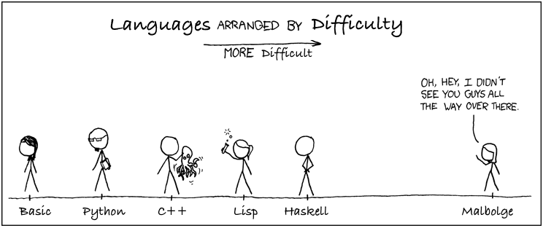
Notes:
https://en.wikipedia.org/wiki/Malbolge
> It’s named after the 8th circle of hell.
> Indeed, the author himself has never written a single Malbolge program.^{[1]}
> The first program was not written by a human being: it was generated by a beam search algorithm designed by Andrew Cooke and implemented in Lisp.^{[2]}
Art Credit: https://xkcd.com/

Slide 26
Incoming wall of text
Sorry about that.

Slide 27
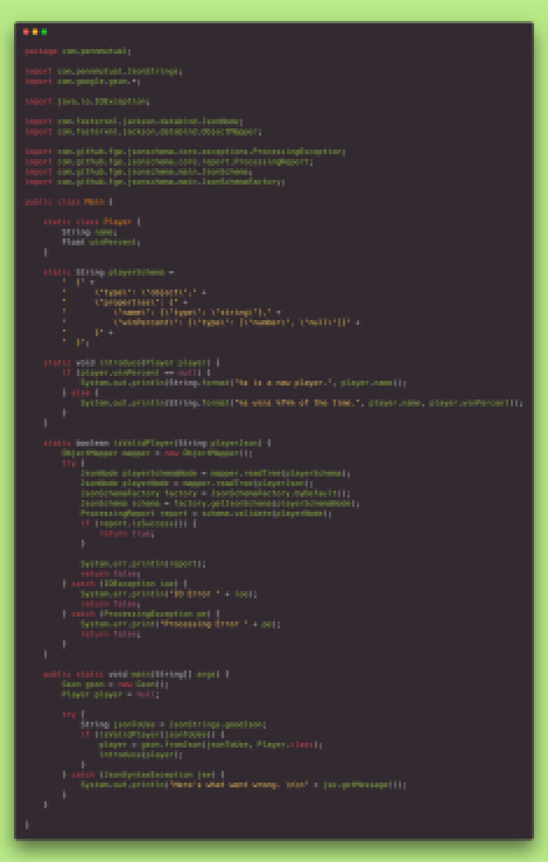
Notes:
What language do we think this is?

Slide 28
Extension | Non-blank Lines | Characters
rs | 24 | 483
hs | 20 | 513
cljs | 19 | 526
elm | 27 | 573
lisp | 17 | 578
lua | 28 | 583
js | 28 | 585
rb | 30 | 587
purs | 23 | 651
py | 27 | 652
ts | 32 | 655
exs | 42 | 710
php | 38 | 718
c | 25 | 748
go | 44 | 1010
java | 65 | 1762

Slide 29

Go := Java lite
Let’s see some snippets
Notes:
Code is large to accomplish this goal the same way as everyone else.
The learning curve might be the best part.

Slide 30
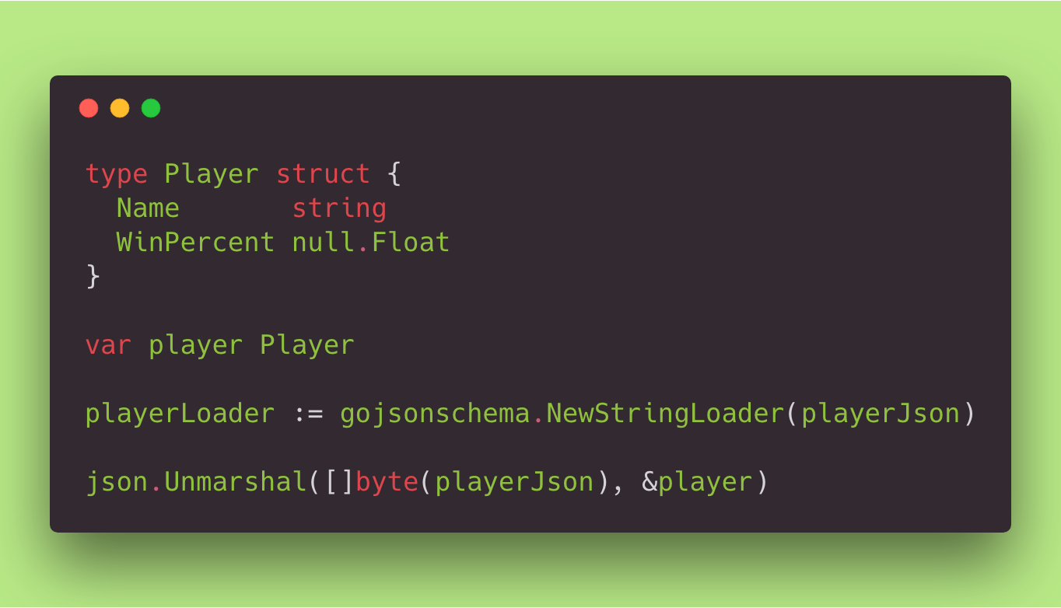
Notes:
Some snippets to show a couple language quirks.
Notice the WinPercent is using a 3rd party library, null, which was designed for SQL interactions.
See how we mix metaphors with var, like JS, and say its type, like Java.
Zoidberg operator
Unmarshaling to a pointer
Go and Java are doing something in common, which causes us to write a bunch more code than we would like.
They’re setting plain old objects’ fields to default primitive values, when we need something more precise.

Slide 31


Elixir
Mo’ snippets
Notes:
Phoenix is to Elixir as Rails is to Ruby
No, we’re not covering Phoenix in here.
Elixir does kind of look like Ruby, so I will spare you most of the syntax.
It’s good for high-availability, concurrent, fault-tolerant applications.

Slide 32
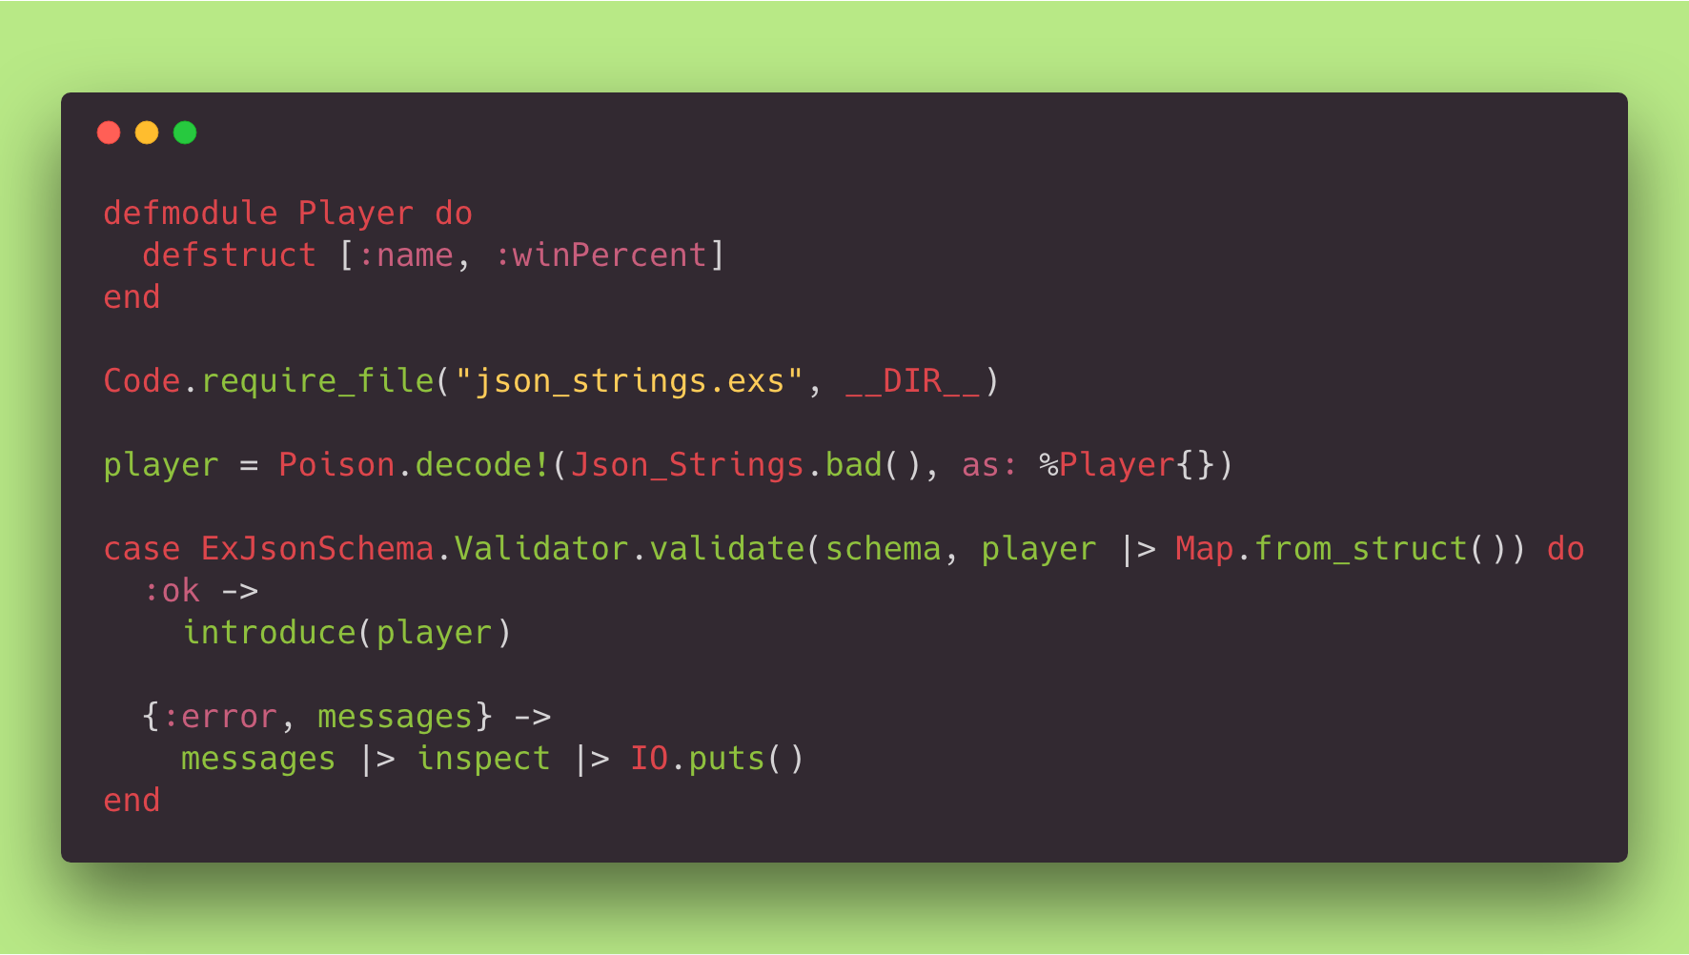
Notes:
Has symbols, called atoms.
Loading a local file is wonky.
Function pipes to first parameter rather than last.
For some reason, it likes percent signs. Uses those when declaring object literals too.
Brackets for tuples?

Slide 33




Enough code
Let’s talk through these.
Notes:
PHP:
Dollar signs
Hack/HHVM
Single threaded, request-based state.
History.
Purescript:
Like Haskell, but younger and compiles to JS.
Easy JS interoperation.
Ugly compiler messages.
May the source be with you.
Lua:
Very fast, though interpreted.
Simple and easy to learn.
Good package manager.
Clojure/Script:
Ouch.
Size of compiled JS.
Horrible compiler.
Elixir:
Phoenix is to Elixir as Rails is to Ruby.
Elixir does kind of look like Ruby, so I will spare you most of the syntax.
It’s good for high-availability, concurrent, fault-tolerant applications.
C:
Intimidating, but easy!
So fast.
No exceptions.
Every function returns something.
Malloc.
May the source be with you.

Slide 34

Last two
Opposite language development speeds
Notes:
Art Credit:
https://www.theadvocates.org/tag/tortoise-and-the-hare/
Rust has a rapid language development release cycle.
Elm is deliberately slow.
Both have the same goal, and operate in much the same way, though in very different places.

Slide 35

Elm
You knew it was coming
Notes:
Front-end, domain-specific, pure functional language.
Decoding JSON is the most hated part of Elm, behind learning curve.
However its does a better job of safely handling outside data than the other languages in this presentation, with one exception.
Compiles to JS so you can use it on the back-end to make a high-confidence bubble, if you REALLY want to.
In the future, may compile to other things.
Best package manager.
Friendly compiler.
Doesn’t have actions like Haskell.
Instead has commands that are just data handed off to the runtime, so that it can do the dirty work.

Slide 36
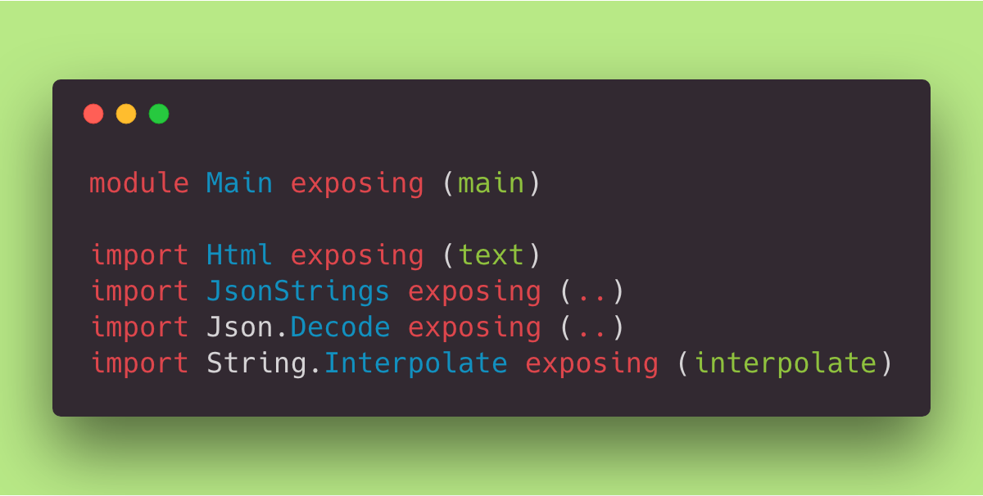
Notes:
We’re breaking this down to highlight the result of deliberate language syntax planning.
It’s similar to Python.
Differ from purescript and Go because they read like English.

Slide 37
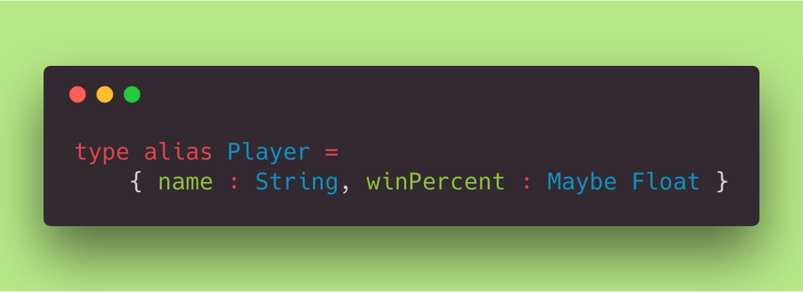
Notes:
This is a constructor.
In Haskell and Rust you need an extra step to derive such a constructor.
This does that for you.
Like TypeScript, colons are for type annotations.

Slide 38
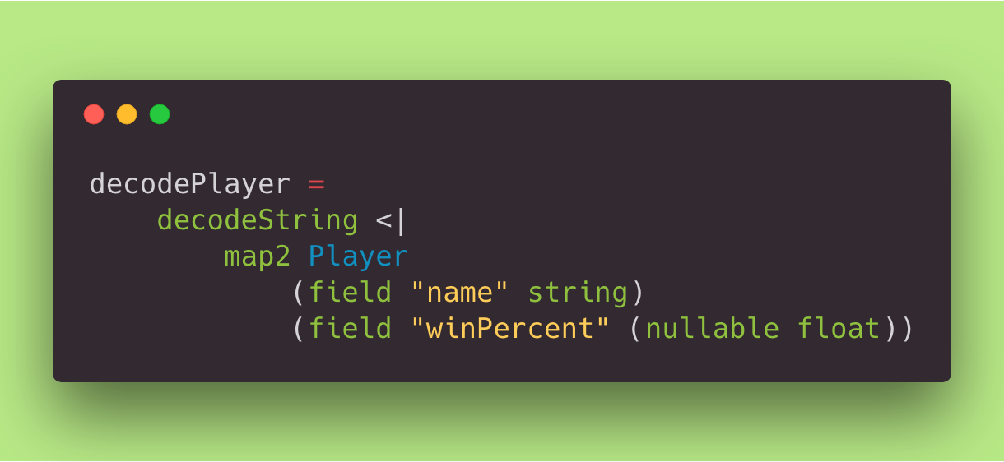
Notes:
This provides both a compile-time check, and a run-time one.
<| is backward function application, to reduce () or let/in
Notice “nullable”.
This is a function that takes a string, and returns a Result that either contains an error message or a Player object.
http://package.elm-lang.org/packages/elm-lang/core/5.1.1/Json-Decode#decodeString

Slide 39
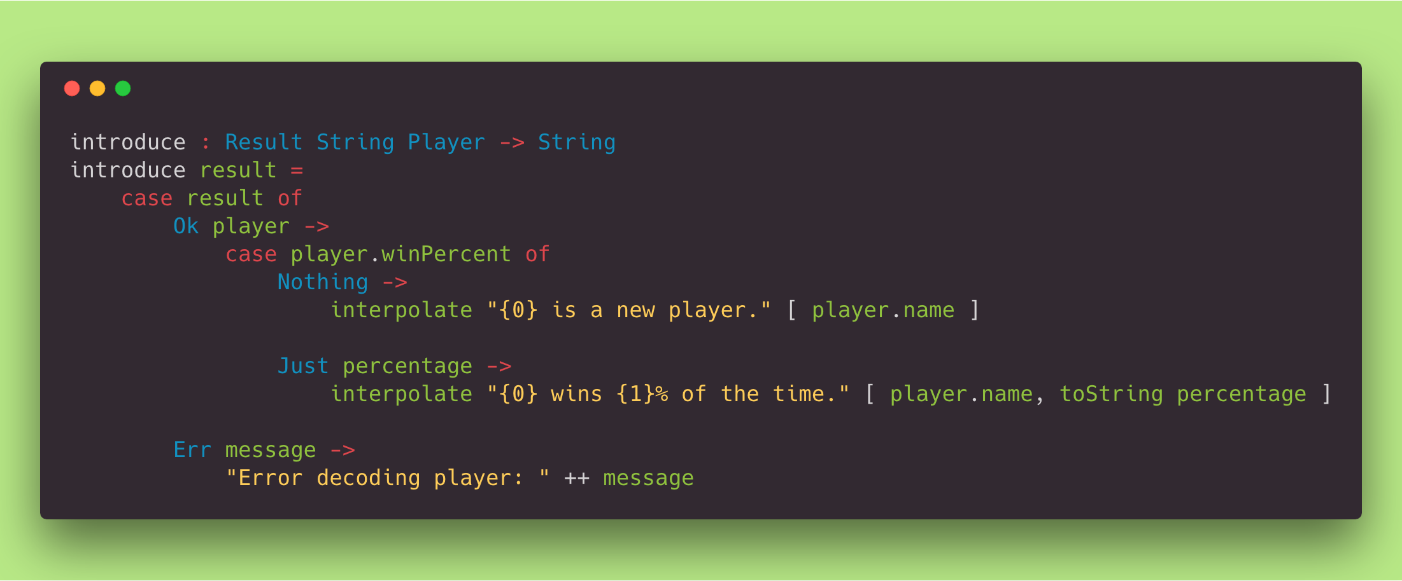
Notes:
You don’t need the type annotation.
Interpolate is a 3rd party library. Elm has no macros, and may never.

Slide 40
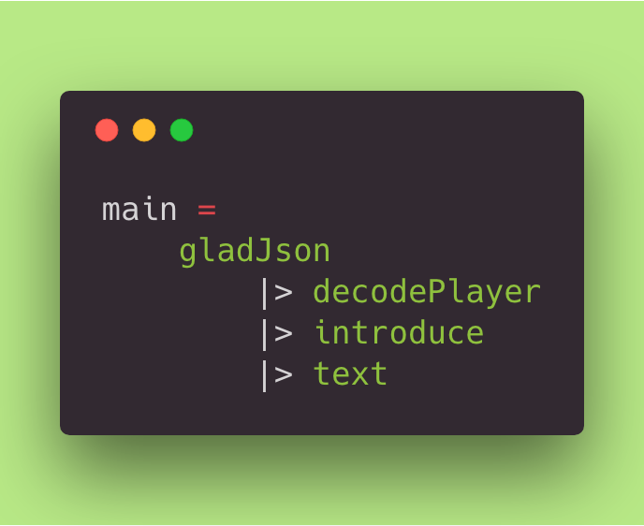
Notes:
|> is forward function application
Each function has an arity of 1.

Slide 41

Winner
Fewest keystrokes 2018
Notes:
Art Credit:
http://asaj.org/talks/lola16/?full#cover
No "Billion Dollar Mistake".
Guarantees no null or dangling pointers by forcing each reference// to borrow its value, during which time the value in memory cannot by destroyed or moved.
You cannot declare a variable unless it has a concrete value of that type.
Rust has no exceptions as those do not play well with multi-threading.
If it compiles, it probably works.

Slide 42
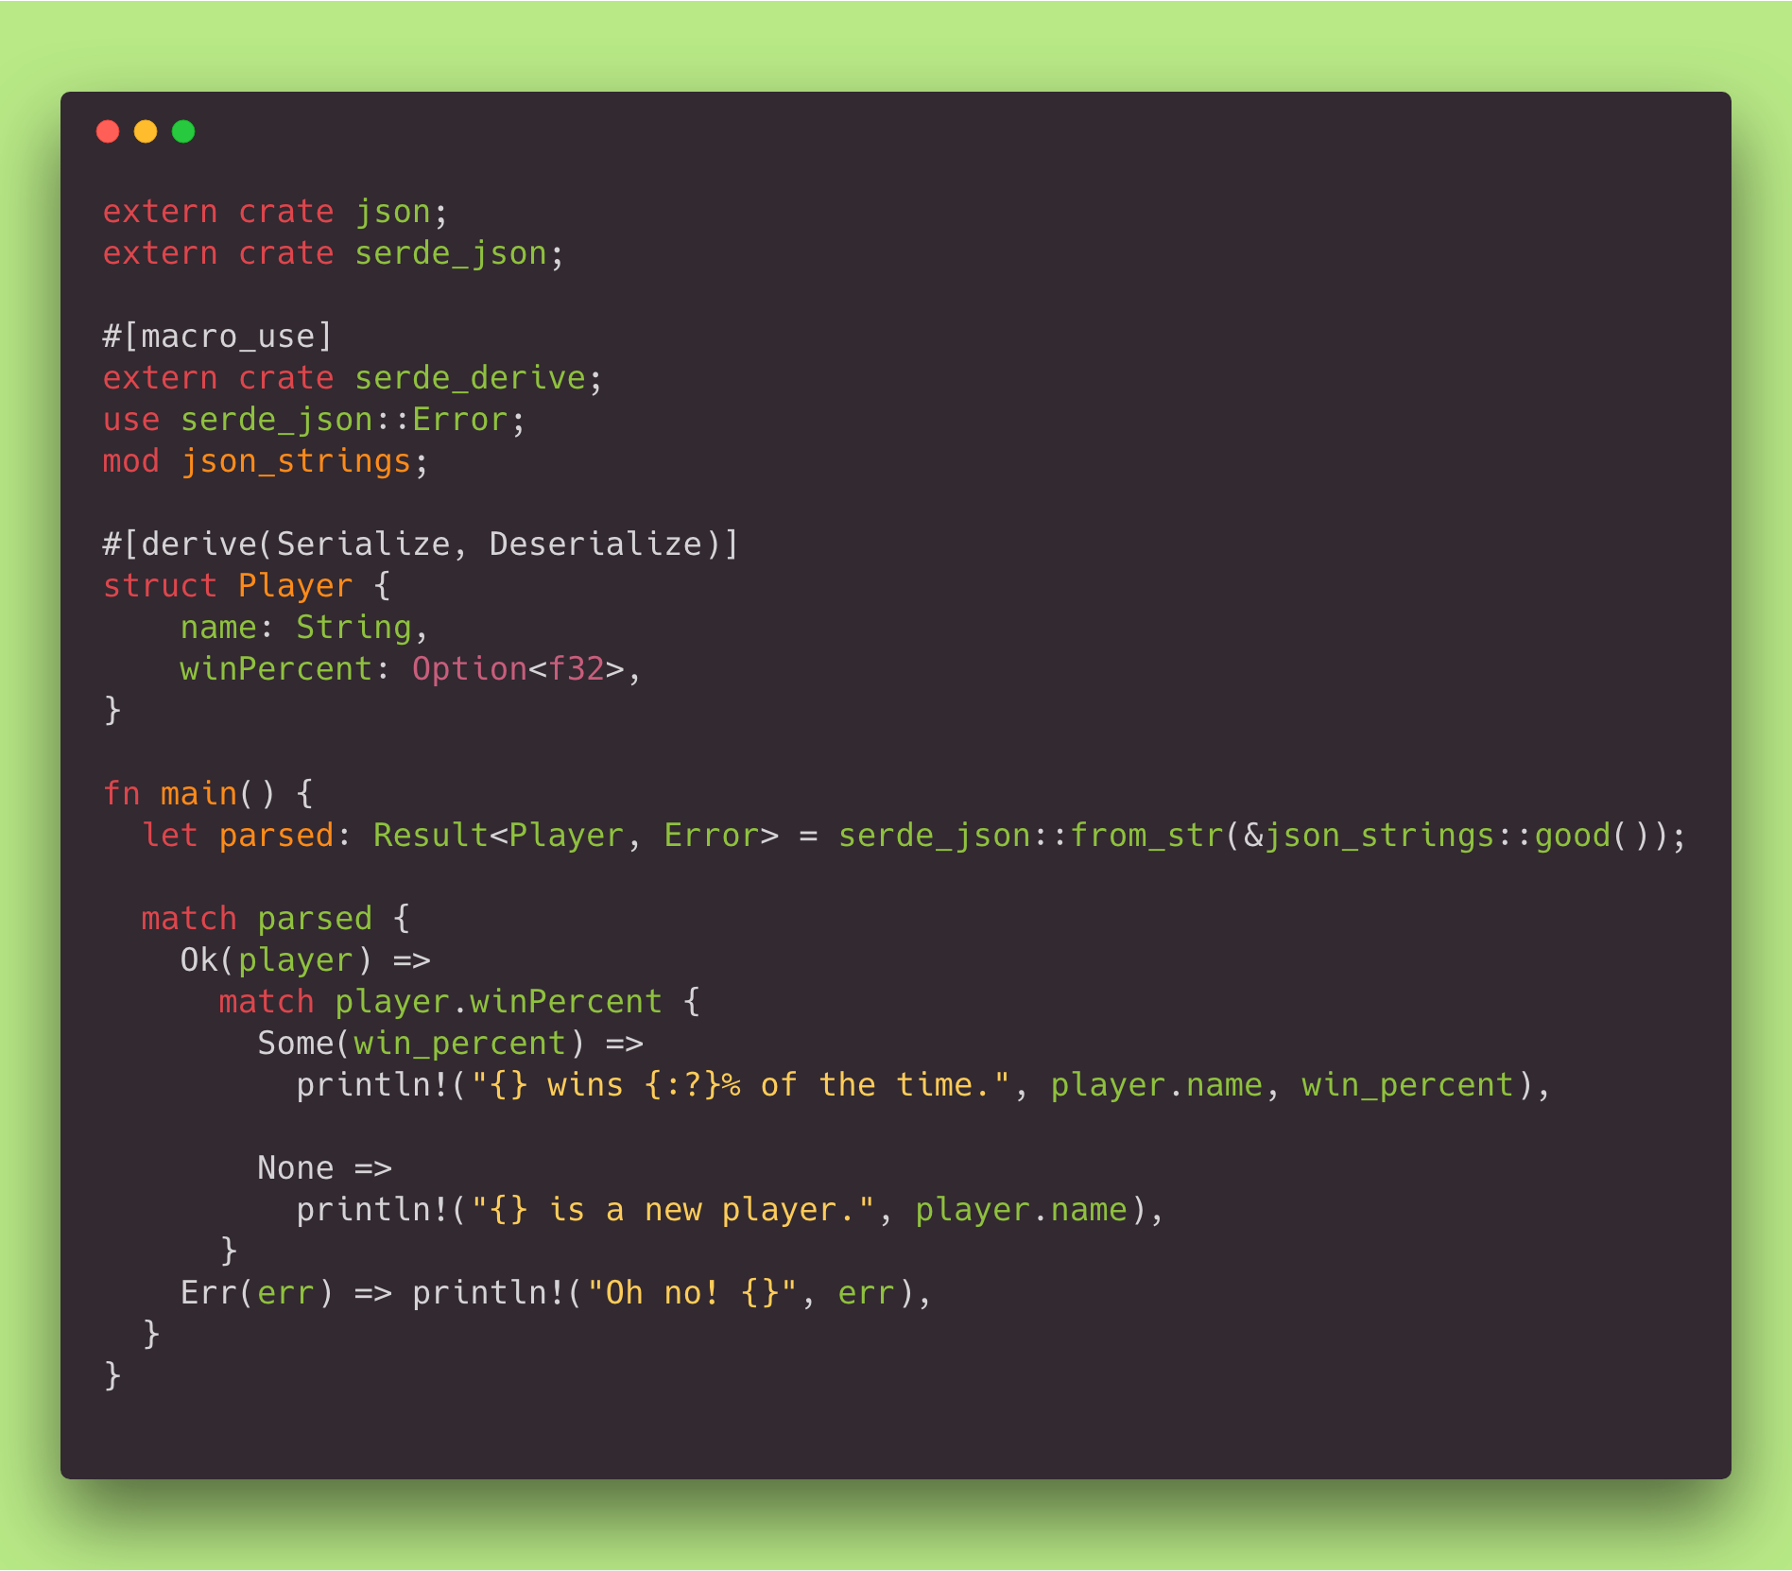
Notes:
This is the smallest implementation of all our languages. So here it is in one slide.
Macros are a feature of last resort!
Cargo brings in crates.
The funky Elvis operator in the first argument of println! is what allows us to pass a Result
Java-like <generics>, though after a colon. Kinda mixing metaphors?
Lots of symbols being used, but not as much as Haskell.

Slide 43


Notes:
Art Credit:
https://pixabay.com/en/question-mark-note-duplicate-2110767/
Nintendo
We can go look at any of these and try live coding in the text editor/terminal.
https://github.com/Pilatch/language-buffet

